Slide 1
Cybersecurity and Cyberwar
: What Everyone Needs to KnowRG
201511054 컴퓨터과학과 임현

Slide 2
1 Preview 2 Story 3 Impressions
Contents

Slide 3
Preview

Slide 4
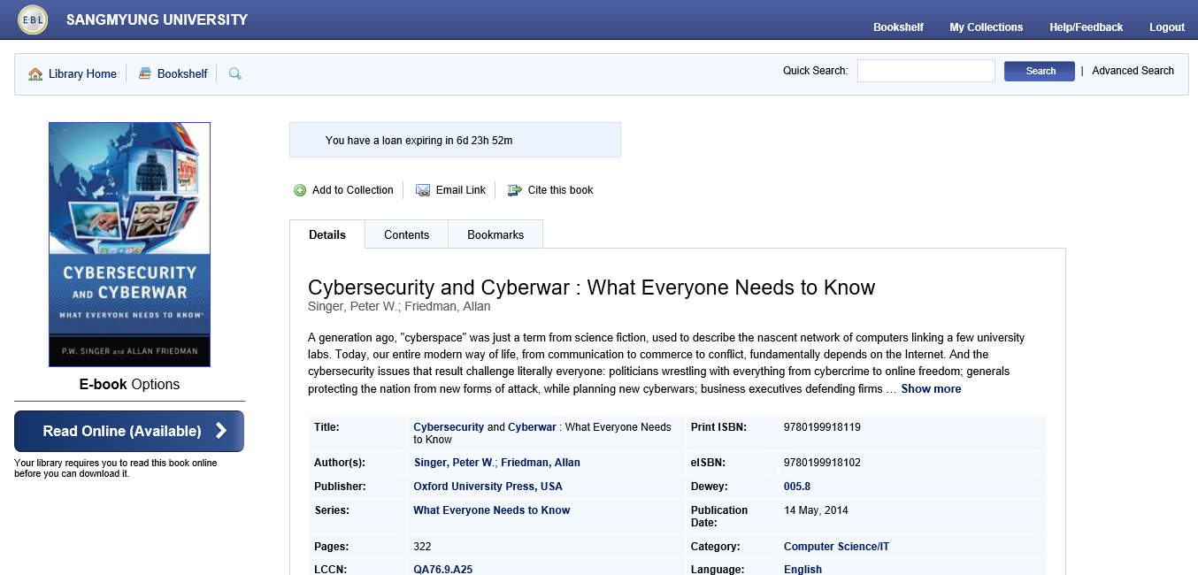
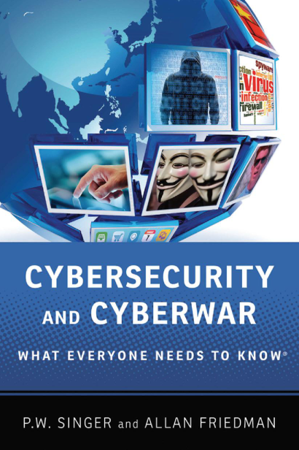
Preview
01

Slide 5
Preview
01
Title: | Cybersecurity and Cyberwar : What Everyone Needs to Know
Author(s): | Singer, P.W.; Friedman, Allan
Publisher: | Oxford University Press
Pages: | 322

Slide 6
Story

Slide 7
Story
02
Contents
"How it all works"
"Why it matters"
"What can we do?"

Slide 8

Story
02
"All this cyber stuff."
The serious problem in modern society is that 97 percent of the 500 companies are hacked but they do not take the fact of being hacked seriously enough.

Slide 9
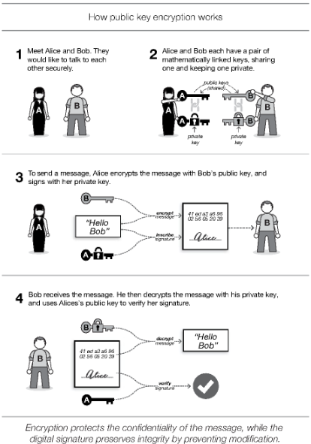
Story
02
"How it all works"
It defined the cyberspace as the dominant platform of the 21st century.
How the Internet works and what is the Internet
There is an old joke that how the security industries have to do to protect your computer.
Just "unplug" is the word.
But this is wrong.
‘Confidentiality’, ‘Integrity’, ‘Availability’, call the "CIA triad", should be followed and adding resilience is also important.
And public-key encryption principle which is informed in the figure is similar to the RSA Cryptosystem which we learned in 'Security Mathematics', so it shows that Number Theory is also important to security.

Slide 10
Story
02
"Why it matters"
We defines Cyber crime as the criminals use digital tools when they steal something or commit illegal things.
Describes the various cyber crime and describes hacking practices
It is widely used in scams so that we see that cyber crime can be committed by anyone who doesn't know IT better.

Slide 11
Story
02
"What can we do?"
Underlines the importance of security once again and explains what you can do to protect yourself.
We must recognize that cyber security is really serious and we must recognize and manage it.

Slide 12
Impressions

Slide 13
Impressions
03
I figure out that people are much less interested in security than I thought.
So I thought I'd like to solve the problem as informing the seriousness of the situation to the people.

Slide 14
Thank you.

